Slide 1
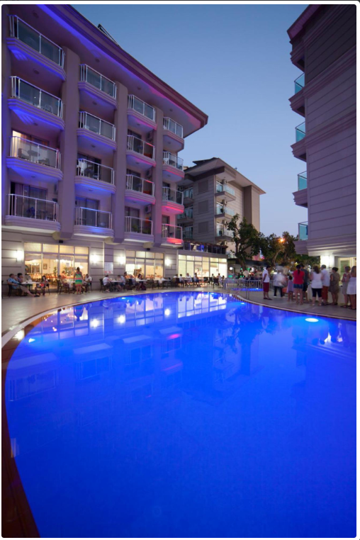
SULTAN SİPAHİ OTEL
SUSTAİNABİLİTY MANUAL
2025

Slide 2

REPUBLİC OF TÜRKİYE
ESTABLISHMENT OF THE REPUBLIC OF TÜRKİYE
After the National War of Independence, which began on May 19, 1919, the First Grand National Assembly of Türkiye convened under the leadership of Mustafa Kemal Atatürk on April 23, 1920.
With the adoption of the first constitution on January 20, 1921, it was declared that “Sovereignty unconditionally belongs to the nation. The legislative and executive powers are vested in the Grand National Assembly on behalf of the Turkish nation.”
On April 23, 1921, with Law No. 112, the first anniversary of the Assembly’s opening was declared a national holiday.
Finally, the Republic was proclaimed on October 29, 1923.

Slide 3
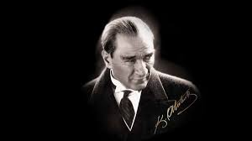
MUSTAFA KEMAL ATATÜRK
(1881-193∞)
FOUNDER AND FIRST PRESIDENT OF THE REPUBLIC OF TÜRKİYE — ATATÜRK
He was born in 1881 in Thessaloniki. His mother was Zübeyde Hanım and his father was Ali Rıza Efendi.
He attended Mahalle School, Şemsi Efendi School, Thessaloniki Civil School, Thessaloniki Military Secondary School, Thessaloniki Military High School, the Military Academy, and finally the Military College.
In 1893, while studying at the Military Secondary School, his mathematics teacher added the name “Kemal” to his first name, and he became known as Mustafa Kemal.
After the Ottoman Empire’s defeat in World War I, the Armistice of Mondros was signed. Following the occupation of the homeland under this agreement, Mustafa Kemal landed in Samsun on May 19, 1919, initiating the National Struggle.
On April 23, 1920, with the opening of the Grand National Assembly of Türkiye, Mustafa Kemal was elected as both Speaker of the Assembly and Head of Government.
After the victory at the Battle of Sakarya, he was honored with the title “Gazi” (Veteran) and the rank of Field Marshal.
Finally, with the proclamation of the Republic on October 29, 1923, Mustafa Kemal became the first President of the Republic of Türkiye.

Slide 4
SULTAN SİPAHİ HOTEL
As SULTAN SİPAHİ HOTEL, we have initiated our sustainability efforts as of 2025.
This sustainability report includes the data and progress for the year 2025.
Our goal is to provide the best and highest-quality service in line with legal requirements while maintaining maximum guest satisfaction together with our entire team. In this context, we aim to share our sustainability progress with our management, team members, guests, suppliers, and all partners, thereby increasing awareness on sustainability and achieving our defined goals.
We continuously develop our objectives by considering changing global conditions, being aware of the responsibilities brought by sustainable tourism, and following the principle of continuous improvement. We continue our efforts to use, protect, and transfer our existing resources to future generations in the most efficient way.
In this regard, we implement the principles of sustainable tourism by:
Raising awareness about sustainability,
Supporting local development and the local economy,
Ensuring local employment without discrimination in terms of gender, race, or vulnerable groups,
Carrying out social projects both within the facility and together with the local community,
Increasing the awareness of our natural, cultural, and historical values,
Keeping guest satisfaction at the highest level,
Efficiently using our resources and reducing environmental impacts.
We are aware of our responsibilities toward nature. Therefore, we conduct several practices in our facility in line with the principles of sustainable tourism.

Slide 5
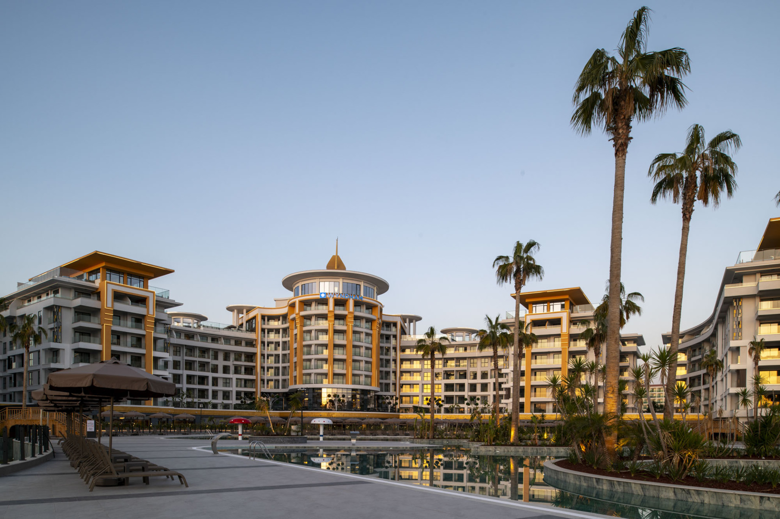
OUR QUALITY AND SUSTAINABILITY POLICY
SULTAN SİPAHİ HOTEL OTEL
By prioritizing social, environmental, and cultural values, we have established and documented an integrated management system built upon quality, food and water safety, occupational health and safety, information security, infectious disease management, and sustainable tourism. Within the framework of national and international laws and standards, we ensure the necessary resources to implement pioneering practices in the tourism sector and continue to develop our corporate culture accordingly.
Through this system, we commit to:
COMPLIANCE WITH LAWS:
To comply with all current legal regulations, national and international standards, and all applicable requirements related to our operations.
CONTINUAL IMPROVEMENT AND ANALYSIS:
To continuously improve by evaluating the needs and expectations of our stakeholders and our internal and external issues, analyzing potential risks and opportunities in advance, and focusing on stakeholder satisfaction in all our activities.
STAKEHOLDER FOCUS:
To identify goals, risks, opportunities, and threats; to provide channels for our employees, guests, local community, and stakeholders to express their needs, requests, suggestions, and complaints; and to monitor and measure system performance and implementation effectiveness with a stakeholder-oriented approach.
EMPLOYEE PARTICIPATION:
To increase awareness and competence of our employees—selected primarily from the local community—by organizing necessary training, ensuring motivation, encouragement, and clear communication, and securing their participation in all activities, including their suggestions.
OCCUPATIONAL HEALTH AND SAFETY:
To provide a safe and healthy environment for our employees, guests, and all stakeholders by establishing an organization capable of responding effectively and promptly to emergencies, and by taking preventive measures to avoid work accidents and occupational diseases.

Slide 6
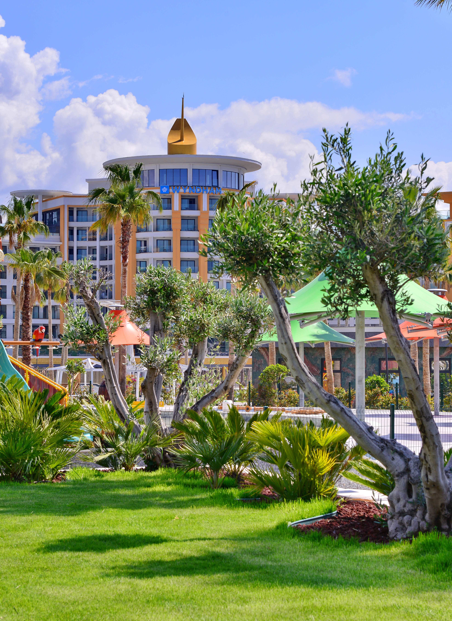
OUR QUALITY AND SUSTAINABILITY POLICY
SULTAN SİPAHİ HOTEL OTEL
FOOD AND WATER SAFETY:
To provide a safe and healthy environment for our employees, guests, and all stakeholders by establishing an organization capable of responding quickly and effectively to emergencies, preventing any illness or incident that may arise from food, water, or infectious sources, and ensuring its effective implementation.
INFORMATION SECURITY:
To protect the confidentiality, integrity, and accessibility of information, and to ensure the personal data security of our employees, guests, and stakeholders.
PROTECTION OF CHILDREN’S AND WOMEN’S RIGHTS:
To provide facilities where children can develop freely, express their thoughts, feelings, and wishes comfortably under the supervision of their parents, and feel safe and respected.
To oppose and actively prevent any behavior that could harm or restrict the rights of children, women, or individuals with limited mobility, and to share this awareness with all employees and stakeholders, taking legal action against such violations when necessary.
ACCESSIBLE LIFE:
To ensure that employees and guests with limited mobility can safely and comfortably access and benefit from all facilities and services by making the necessary arrangements within our premises.
FAIR EMPLOYMENT AND GENDER EQUALITY:
To promote women’s participation in the workforce by upholding the principle of equality, preventing discrimination, protecting their rights, and providing a working and living environment that supports work–life balance.

Slide 7
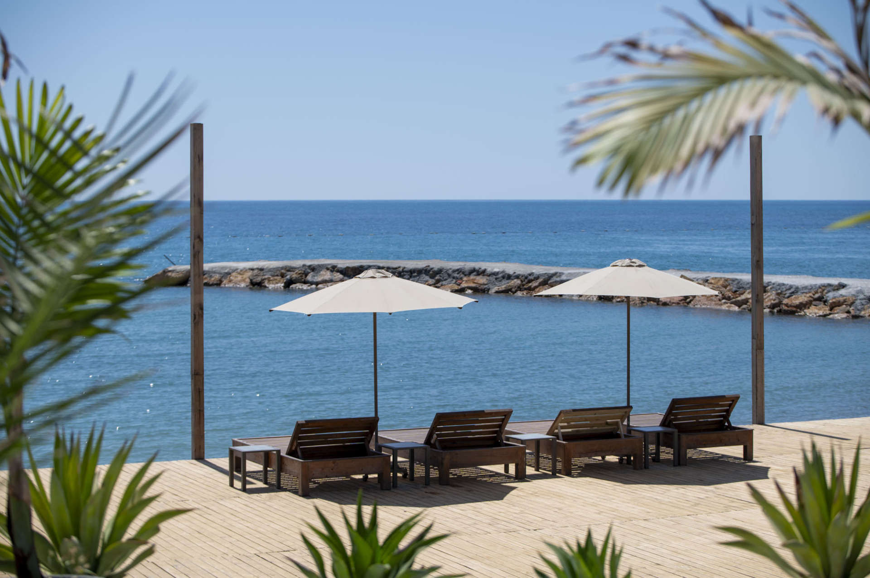
OUR QUALITY AND SUSTAINABILITY POLICY
SULTAN SİPAHİ HOTEL OTEL
PROTECTION OF THE ENVIRONMENT AND NATURAL LIFE:
While planning our investments and operations, we take into account the impact on protected sensitive areas, historical heritage, and the integrity of the natural and cultural environment. We ensure the efficient and economical use of natural resources and prefer local, regional, and ecosystem-appropriate plants, practices, and materials in our landscaping activities.
We adopt the philosophy of “producing as much energy as we consume,” and we aim to reduce our carbon footprint caused by energy and natural resource use contributing to climate change. We plan and invest in energy-saving technologies and methods suitable for current conditions, measure and analyze consumption, and take continuous improvement actions to reduce usage.
We guarantee that no prohibited, endangered, or threatened plant or animal species will be kept or used within our facilities or operations, and that any such occurrence will be promptly reported to the competent legal authorities.
PROTECTION OF COMMUNITY AND CULTURAL VALUES:
We contribute to the preservation, development, and promotion of local and regional foods, areas, and traditions that hold historical, archaeological, cultural, or spiritual significance in our country and region.

Slide 8
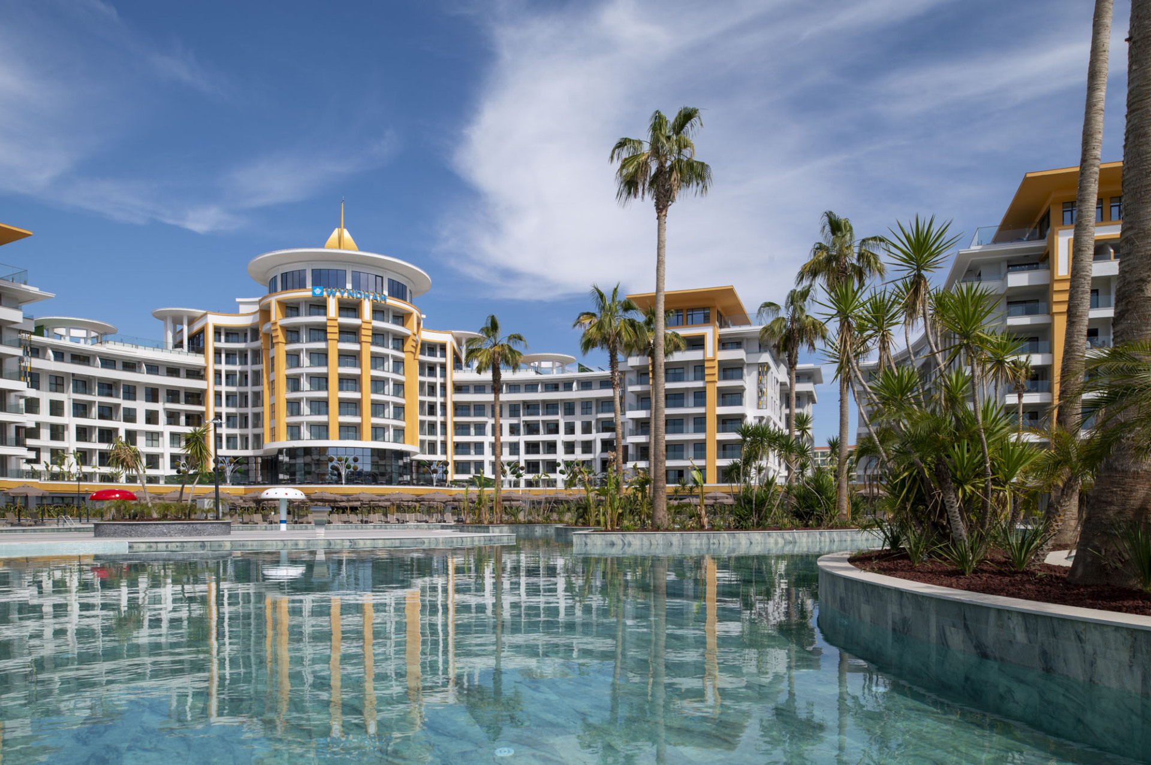
OUR QUALITY AND SUSTAINABILITY POLICY
SULTAN SİPAHİ HOTEL OTEL
PROCUREMENT:
When purchasing all goods and materials, we evaluate their quality and suitability together with users, analyze their compliance within our operations, and audit our suppliers. We aim to ensure that the environmental, ecological, and human health impacts of the products we procure are minimized. We prioritize products with less packaging, lower carbon footprints, and those supplied legally from local producers or fair-trade suppliers whenever possible.
ZERO WASTE:
Within our facilities, as part of the “Zero Waste” project, we ensure the correct and on-site separation of waste through information and awareness activities. We prefer recyclable materials and ensure effective segregation of generated waste. Non-recyclable materials are disposed of by authorized organizations. We minimize the use of single-use products to reduce the total amount of waste generated.
We hereby commit to implementing all these principles effectively and continuously improving our sustainability performance.

Slide 9
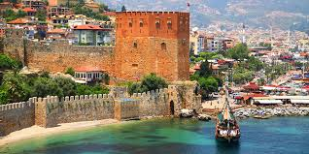
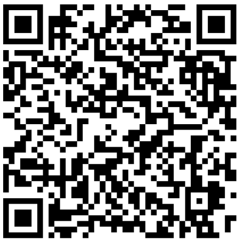
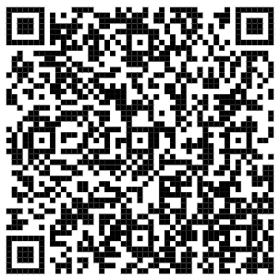
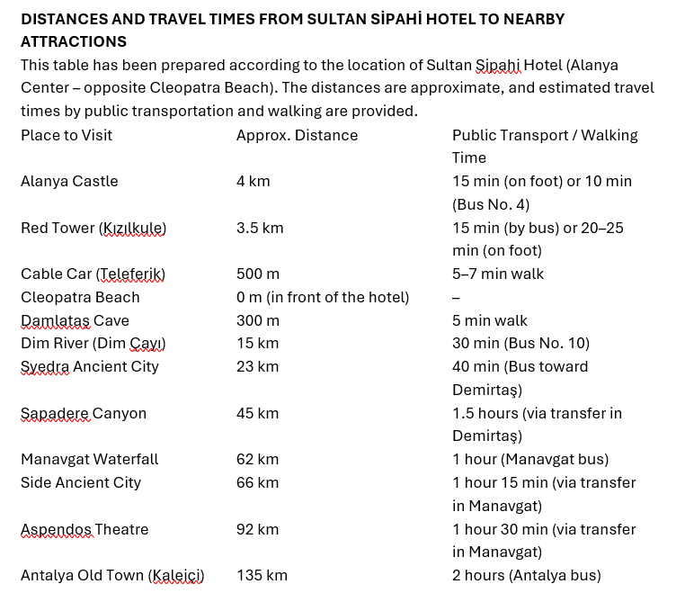
MAPS and ROUTES
Scan the QR code for Konaklı bus routes and schedules.
Scan the QR code for Alanya bus routes and schedules.

Slide 10
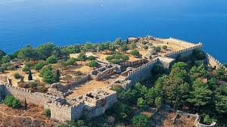
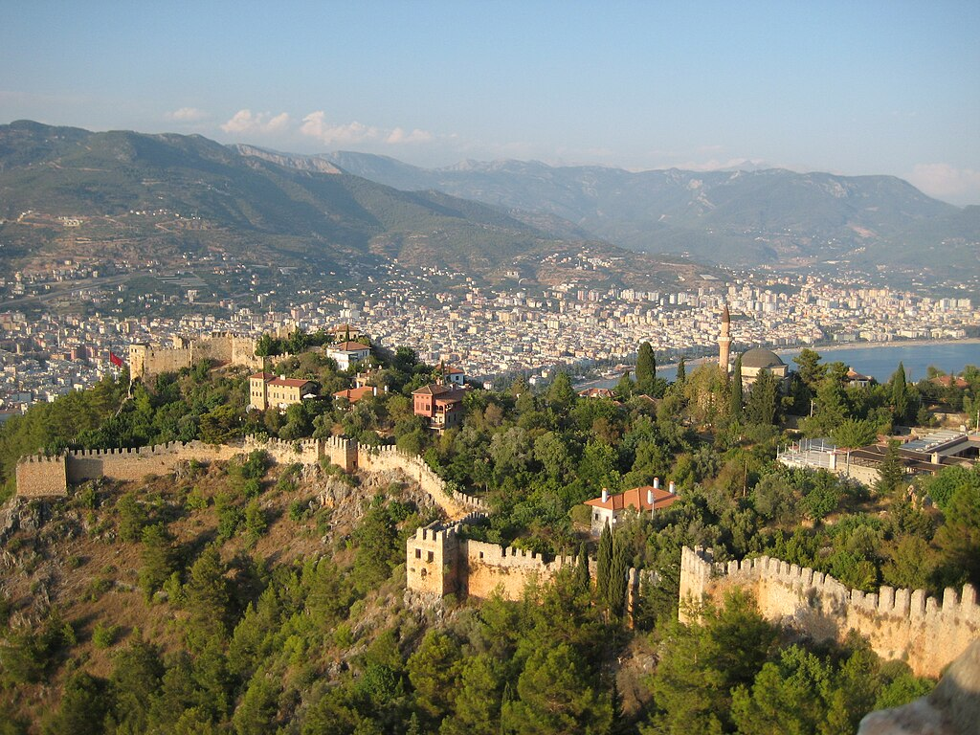
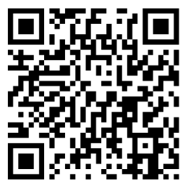
ALANYA CASTLE
Alanya Castle is one of the symbols of Alanya, a district of Antalya. It is located on a peninsula rising approximately 250 meters above sea level. The total length of its walls is about 6.5 kilometers.
The castle, known as Kandeleri in ancient times, was originally built during the Hellenistic period. Its current historical structure dates back to the 13th century Seljuk era. It was reconstructed in 1221 by Seljuk Sultan Alaeddin Keykubad I, who conquered the city.
The castle has 83 towers and 140 bastions in total. During the Middle Ages, nearly 1,200 cisterns were built within the walls to supply water to the city — some of which are still in use today.
The fortifications extend in a planned layout, following the route of Ehmedek, İçkale (Inner Castle), Adam Atacağı, Cilvarda Cape, Arap Evliyası, and Esat Bastion, continuing past the Tophane (Armory) and Shipyard (Tersane), and ending at the Red Tower (Kızılkule).
It remains one of the best-preserved examples of medieval military architecture on the Mediterranean coast.

Slide 11
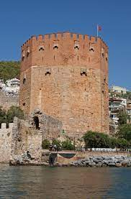
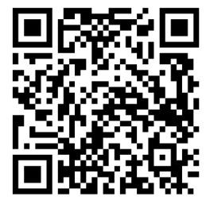
RED TOWER (KIZIL KULE)
The Red Tower (Kızıl Kule) is a historic structure located in Alanya, Türkiye, and is considered one of the city’s main symbols—it even appears on the city’s flag.
Construction began during the early reign of the Seljuk Sultan Alaeddin Keykubad I and was completed in 1226. To finish the building, the Sultan brought the master architect Ebu Ali Reha from Aleppo, Syria.
The octagonal tower, made of distinctive red bricks that give it its name, was built to protect the shipyard (Tersane), which dates back to 1221.
The Red Tower remains one of the finest examples of medieval military architecture and is the best-preserved Seljuk structure in the city today.

Slide 12
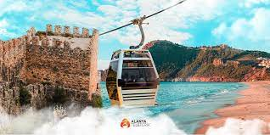
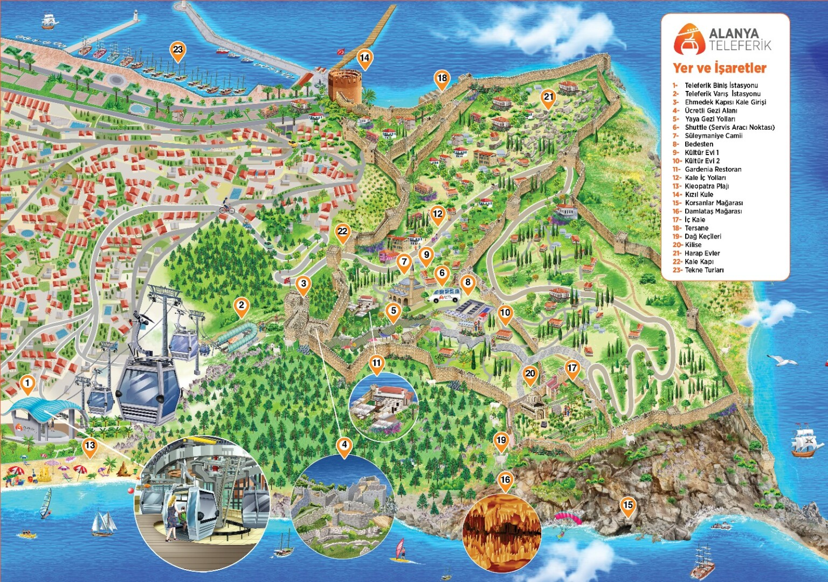
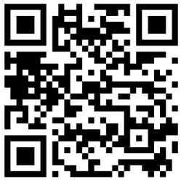
ALANYA CABLE CAR
Alanya Cable Car offers eco-friendly transportation through its technology gracefully integrated into nature. Great care has been taken at every stage of its construction and operation to protect the environment and use natural resources efficiently.
The system incorporates all the advantages of ecological transportation, providing a sustainable and modern way to access Alanya Castle while minimizing environmental impact.
Designed to operate in all weather conditions—including rain, wind, and high temperatures—the Alanya Cable Car continues to function safely and smoothly throughout the year.

Slide 13
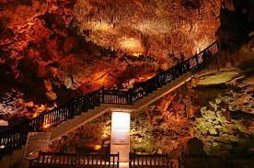
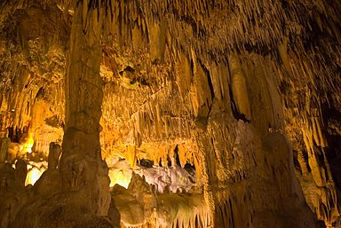
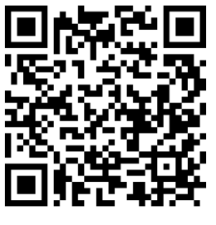
DAMLATAŞ CAVE
Damlataş Cave is a seaside cave located in Alanya, Antalya, about 3 km from the city center, on the western shore beneath Alanya Castle.
The cave gets its name from the dripping water droplets that continuously fall from its stalactites (“Damlataş” means “dripping stone” in Turkish). It was discovered by accident in 1948 during the construction of the harbor when a dynamite blast revealed its entrance.
Decorated with thousands of stunning stalactites and stalagmites, the cave was immediately taken under protection and opened to tourism after scientific studies were conducted.
Damlataş Cave is the first cave in Türkiye to be opened to tourism and is also believed to have therapeutic air properties beneficial for people with respiratory conditions, particularly asthma.

Slide 14
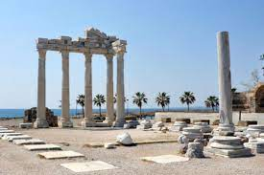
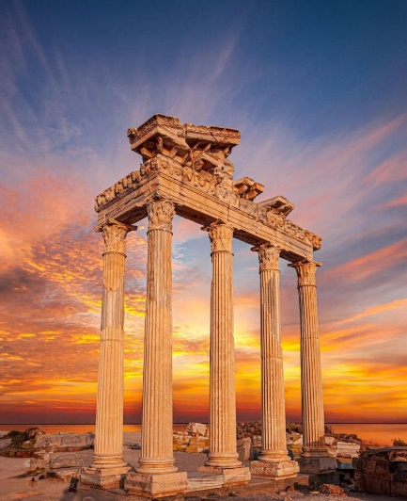
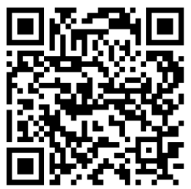
SIDE ANCIENT CITY
The ancient city of Side was founded in the 7th century BC and is among the most significant historical settlements in the region. Located in the Pamphylia region, this ancient city first came under the rule of the Lydian Kingdom and remained within its domain for many years.
Later, it became part of the Persian Empire, and after Alexander the Great’s conquest of Anatolia, Side came under the control of the Macedonian Kingdom.
Today, Side is renowned for its impressive ruins such as the Temple of Apollo, ancient theatre, Roman baths, and city walls, all reflecting the grandeur of classical antiquity. It is one of Türkiye’s most visited archaeological sites and an essential part of the region’s cultural heritage.

Slide 15
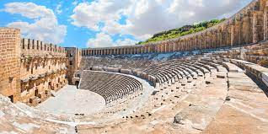
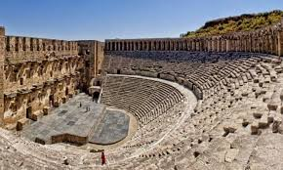
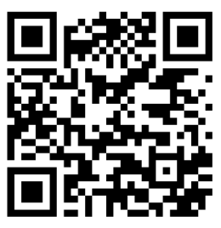
ASPENDOS ANCIENT THEATRE
The Aspendos Theatre, located near the ancient city of Aspendos in Antalya Province, is one of the best-preserved Roman theatres in the world. Built in the 2nd century AD during the reign of Emperor Marcus Aurelius, it was designed by the architect Zeno, a native of Aspendos.
The theatre could originally accommodate around 15,000 spectators and was used for performances, festivals, and public gatherings. Its remarkable acoustics and architectural symmetry have allowed it to remain functional for nearly two millennia.
Today, Aspendos Theatre continues to host concerts and cultural events, maintaining its reputation as a symbol of ancient artistry and engineering excellence. It stands as a testament to the grandeur of Roman architecture in Anatolia.

Slide 16
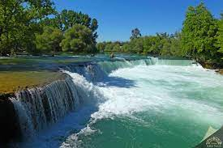
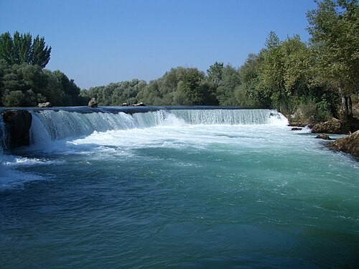
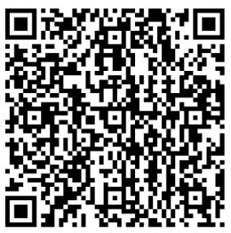
MANAVGAT WATERFALL
Manavgat Waterfall is located on the Manavgat River in the Manavgat district of Antalya. Although it flows from a relatively low height, it spreads widely and carries a strong water flow across a large area.
The area surrounding the waterfall offers picnic areas, restaurants, and fish dining facilities, making it a popular recreation spot for visitors.
As of March 15, 2023, by presidential decree, the waterfall and its surrounding region have been officially designated as a “Strictly Protected Sensitive Area”, recognizing its environmental and natural importance for conservation.

Slide 17
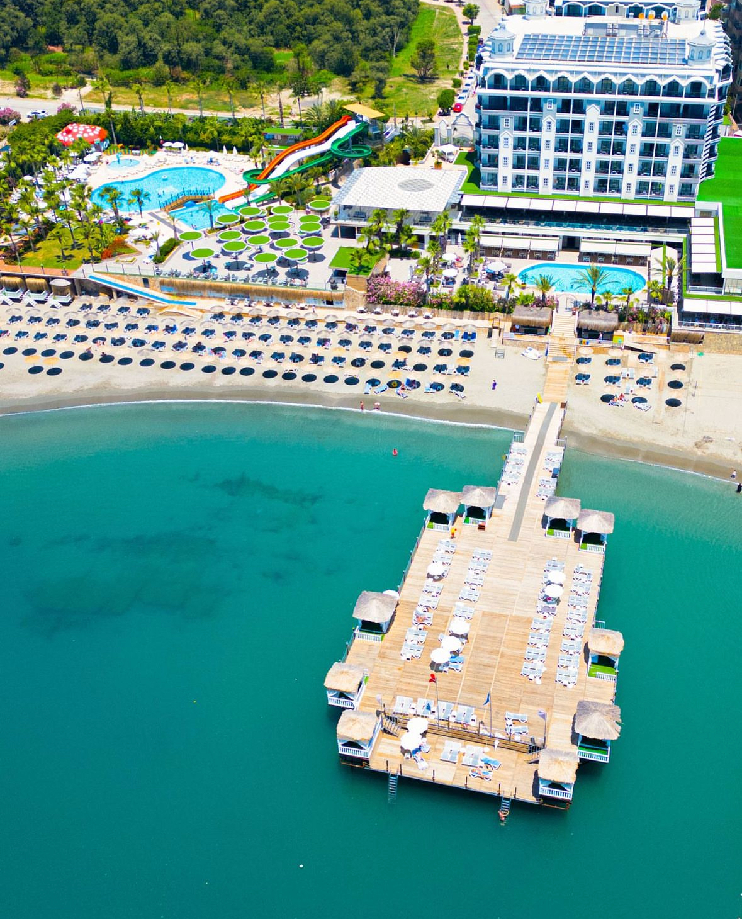

HOW TO GET THERE?
ALANYA CASTLE
Take a Konaklı bus from in front of the hotel to Alanya city center. From there, you can reach the castle either by the Alanya Cable Car (from Damlataş) or local buses going up to the castle.
ALANYA HARBOR – KIZILKULE (RED TOWER)
Take a Konaklı bus from in front of the hotel to Alanya city center. Then take a local bus heading to the harbor area.
MANAVGAT – SIDE
From the main road in front of the hotel, take a bus heading toward Antalya. It takes about 1.5 hours to reach Manavgat or Side town centers.
ANTALYA
From the main road, take a bus to the bus terminal (otogar). Antalya city center can be reached in approximately 2.5 hours by intercity buses.
ANTALYA – GAZİPAŞA AIRPORTS
Guests can reach Antalya Airport in about 2 hours and Gazipaşa Airport in about 1 hour using transfer vehicles arranged by their travel agencies.
ALANYUM SHOPPING MALL
Take a Konaklı bus from in front of the hotel to Alanya city center, then transfer to a local bus heading to Alanyum Shopping Mall.
Public transportation within the city is provided by regulated minibuses or municipal buses using Kent Cards.
Guests may also use the nearby taxi stands for direct transportation.

Slide 18
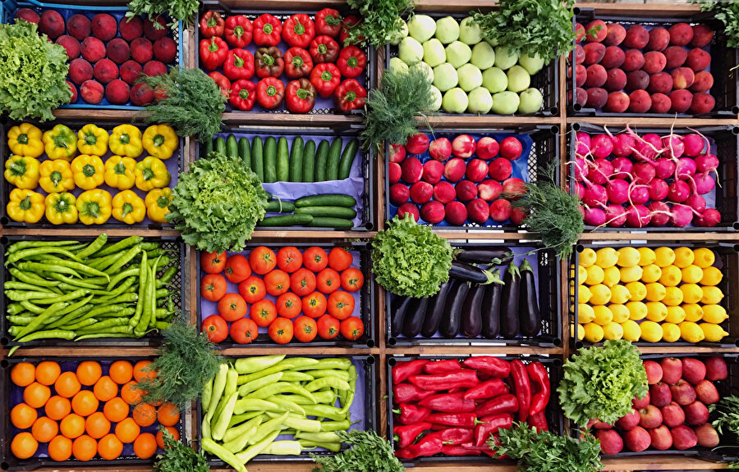
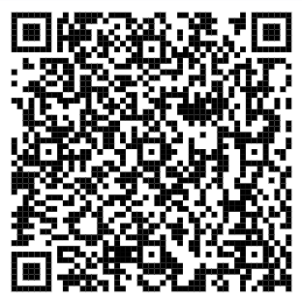
LOCAL MARKETS (BAZAARS)
FRIDAY MARKET
The Friday Market (Cuma Pazarı) is set up every Friday on Şekerhane, Sinanoğlu Street.
It is one of Alanya’s most vibrant and popular local markets where you can find fresh fruits, vegetables, clothing, spices, souvenirs, and local products.
You can reach the market from the hotel on foot in about 15–20 minutes.
It is also easily accessible by local minibuses or buses operating throughout Alanya and nearby areas.
ALANYA LOCAL MARKETS
For detailed information about other local bazaars in Alanya, you can scan the QR code provided.
It will guide you to an updated list of market days, locations, and transportation options throughout the Alanya region.

Slide 19
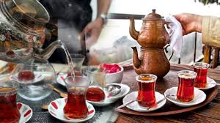
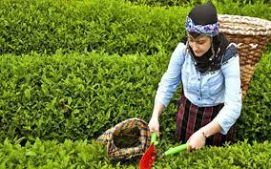
CULTURAL INFORMATION
TURKISH TEA
In Türkiye, a unique type of black tea is cultivated along the Eastern Black Sea coast.
Commonly known as Turkish tea, it is brewed with fine roasted black tea leaves and traditionally served in small tulip-shaped glasses called “ince belli”, which highlight its deep color and aroma.

Slide 20


TURKISH COFFEE
Turkish coffee is one of the oldest coffee preparation and brewing methods, originating from the Ottoman Empire and holding great importance in Turkish culture.
It has a unique identity and tradition characterized by its distinct taste, foam, aroma, and presentation.
It is also the only type of coffee served with its grounds (telve).
In 2013, Turkish coffee culture and tradition was inscribed on UNESCO’s Representative List of the Intangible Cultural Heritage of Humanity on behalf of Türkiye.

Slide 21
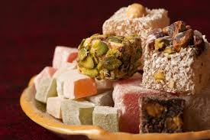
TURKISH DELIGHT
Turkish delight (lokum) is a traditional Turkish sweet.
Although known in Anatolia since around the 15th century, it became especially popular within the Ottoman Empire in the 17th century.
It was introduced to Europe in the 18th century by an English traveler under the name “Turkish Delight.”
Originally made with honey or molasses and flour, the recipe evolved in the 17th century with the introduction of refined sugar (known as “kelle şekeri”) and starch, which greatly improved its texture and taste.

Slide 22
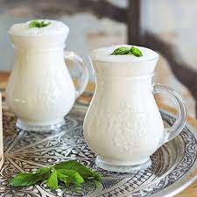
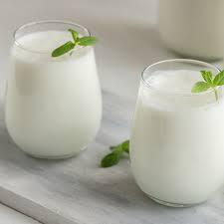
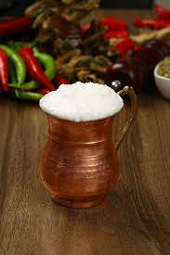
AYRAN
Ayran is a traditional Turkish drink made by mixing yogurt with water.
It is one of the most popular beverages in Turkish cuisine.
Historically, during the Göktürk period (552–745 AD), people added water to sour yogurt to reduce its acidity — this is believed to be how ayran was first discovered.
The term “ayran” was first recorded in “Divan-ı Lügat-it Türk”, an ancient Turkish dictionary, where it was defined as “a drink made from milk.”

Slide 23
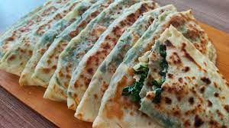
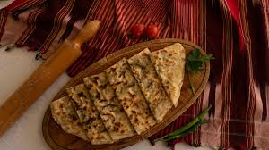
GÖZLEME
Gözleme is a traditional Turkish pastry made by filling thinly rolled dough (yufka) with various ingredients and cooking it on a convex griddle (sac) over a wood fire.
The word’s origin dates back to the Seljuk period, when the term “Közmen” was used to describe bread cooked over embers.
Over time, through changes in dialects and pronunciation, it evolved into the modern name “gözleme.”

Slide 24
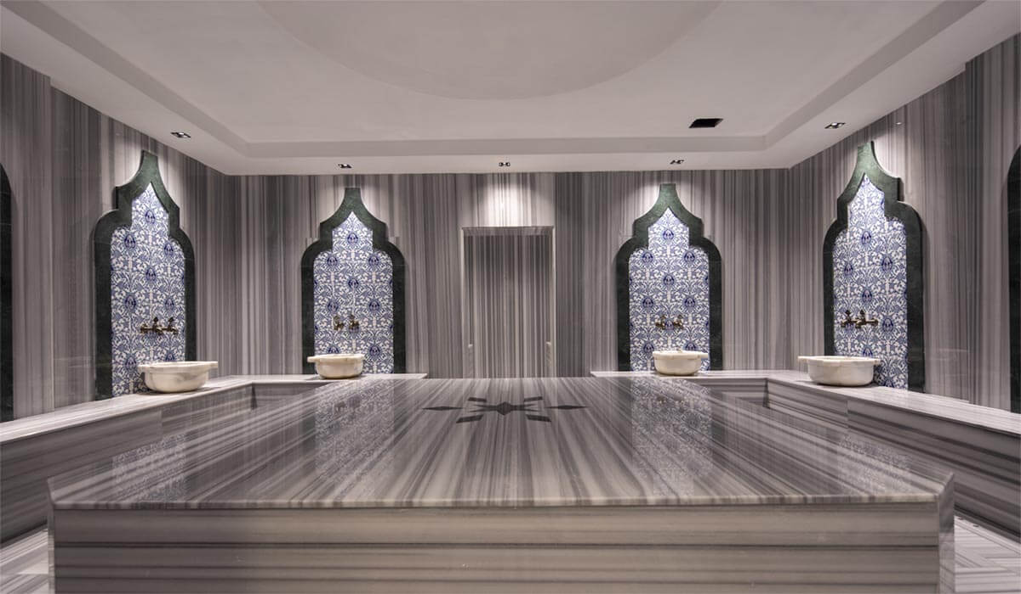
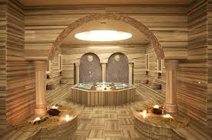
TURKISH BATH
In Anatolia, the Turkish bath (hamam) tradition dates back to ancient times.
The Turks brought their bathing customs from Central Asia to Anatolia, blending them with the marble bath culture of earlier civilizations.
Over time, hamams became places for social gatherings and celebrations.
Even today, traditions such as “bridal bath,” “postpartum bath,” “baby’s fortieth-day bath,” “vow bath,” “mourning bath,” and for men “groom’s bath,” “circumcision bath,” “soldier’s bath,” and “holiday bath” are still practiced, preserving this cultural heritage.

Slide 25
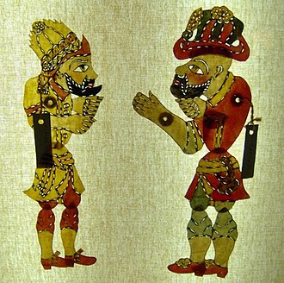
KARAGÖZ İLE HACİVAT
Karagöz and Hacivat is a traditional Turkish shadow play based on imitation and dialogue, performed with two-dimensional figures projected onto a screen. The puppeteer controlling the figures is called a “hayali.”
The characters’ movements are synchronized with voice changes and gestures, creating humor and satire.
It is uncertain whether Karagöz and Hacivat were real people, as their origins remain surrounded by legend. Even if they did exist, they were likely not considered historically significant enough to be recorded in the chronicles of their time.

Slide 26
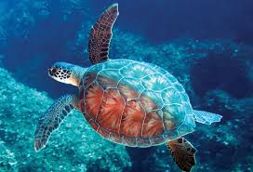
CULTURAL AND NATURAL HERITAGE – SEA TURTLE
Apart from coming ashore to lay their eggs, Caretta caretta sea turtles spend their entire lives in the sea. They are classified as an endangered species.
In Turkey’s Mediterranean coasts, both the loggerhead sea turtle (Caretta caretta) and the green sea turtle (Chelonia mydas) nest.
Studies conducted across the Mediterranean indicate that the most significant nesting areas for the Caretta caretta species are located in Turkey and Greece.

Slide 27
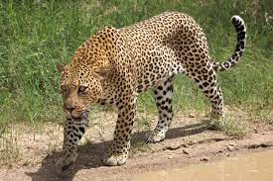
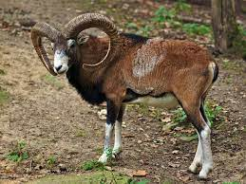
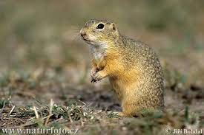
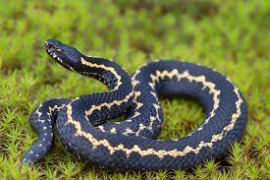
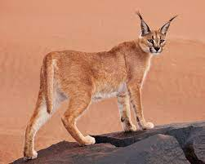
ENDEMIC ANIMAL SPECIES
DENİZ KAPLUMBAĞASI
Caretta Caretta
ANADOLU PARSI
Pantera pardus tuttiana
ANADOLU MİFLONU
Ovis orientalis anatolica
GELENGİ
Citellus citellus
HOPA ENGEREĞİ
Vipena kaznakovi
STEP VAŞAĞI
Felis caraca

Slide 28

CULTURAL AND NATURAL HERITAGE – SAND LILY (Pancratium maritimum)
The Sand Lily (Pancratium maritimum) belongs to the Amaryllidaceae family and grows mainly on Mediterranean sand dunes.
It is a perennial bulbous plant native to the Mediterranean region and is considered endemic.
In Turkey, it is legally protected, and harming or uprooting the plant results in penalties.
Sand lilies usually bloom between August and October and are often found just a few meters from the sea, maintaining their long, spear-like evergreen leaves throughout winter.

Slide 29





ENDEMIC PLANT SPECIES
KUM ZAMBAĞI
Pancratium maritimum
TOROS ORKİDESİ
Himantoglossum Montis-tauri
BAYTOP ÇİĞDEMİ
Colchicum Baytopiorum
FASELİS BURÇAĞI
Lathyrus Phalitanus
SİDE CANAVAR OTU
Orobanche Sideana
PERGE HAVA CIVASI
Alkanra Macrophilla

Slide 30
THINGS TO CONSIDER WHEN VISITING LOCAL, HISTORICAL, ARCHAEOLOGICAL, CULTURAL AND SPIRITUAL SITES
Please remove your shoes, keep quiet, and follow the dress code (such as covering the head, shoulders, and knees) when entering places of worship and sacred sites.
We kindly ask you to respect the privacy of local people and not to take photos or videos without permission.
Please ask parents before taking photos of children and avoid physical contact.
To help protect natural and archaeological areas, please dispose of your waste in designated bins and avoid behaviors that may harm the environment.
Refraining from participating in activities that disregard animal welfare (such as donkey rides or animal photo shows) is highly important for sustainable tourism principles.
Choosing local guides and purchasing local products will help you build cultural connections and contribute to the local economy.
Respecting the traditions, beliefs, and lifestyles of local people supports cultural sustainability.
Be respectful to all living beings and the natural environment; please avoid leaving environmentally harmful items (such as single-use plastics or cigarette butts) in nature.
When joining local festivals or community events, seek information from local guides and act in accordance with community rules.

Slide 31





FOR OUR ENVIRONMENT
DearGuests,
When choosing sprays, deodorants, perfumes, sunscreens, and insect repellents for personal care, selecting products that do not harm nature is the best investment for a sustainable environment.
If a sunscreen contains any of the following ingredients, please look for a marine-safe alternative: Oxybenzone, Benzophenone-1, Benzophenone-8, OD-PABA, 4-Methylbenzylidene Camphor, 3-Benzylidene Camphor, nano-Titanium Dioxide, nano-Zinc Oxide, Octinoxate, Octocrylene.

Slide 32





EXPERIENCE LOCAL CULTURE
We place great importance on bringing the essence of Alanya and Turkish cuisine to life within our hotel.

Slide 33
SMALL STEPS FOR THE ENVIRONMENT, BIG IMPACTS
Separate Recyclable Waste
Contribute to recycling by collecting paper, glass, metal, and plastic waste separately.
Choose Glass and Durable Materials Instead of Plastic
Glass bottles are 100% recyclable and healthier for daily use.
Less Chemicals, More Natural Cleaning
Use eco-friendly cleaning products to protect both your health and the environment.
Opt for Ecological Alternatives to Single-Use Products
Consider using items like metal straws, bamboo brushes, and solid soaps.
Use Cloth Bags When Shopping
Cloth bags can be reused many times and help reduce plastic bag waste.
Prefer Walking Instead of Driving Short Distances
A healthy and environmentally friendly choice that reduces your carbon footprint.
Use Water Consciously
Small steps like turning off the tap while brushing your teeth make a big difference.
Be Mindful of Electricity Use
Unplug devices and turn off lights when not in use to prevent unnecessary energy loss.
Be Aware of the Origin of What You Consume
Learning how and where your food, clothes, or items are produced helps you make more ethical and eco-friendly choices.

Slide 34
SMALL STEPS FOR THE ENVIRONMENT, BIG IMPACTS
Small Habit Changes Make a Big Difference
Using cloth bags, choosing glass instead of plastic, or carrying a thermos—all reflect our responsibility to nature.
Let’s Not Forget Our Street Friends
Whether it’s hot or cold, a bowl of water or food left outside your door can mean a lot to them.
Don’t Waste Water
Leaving the tap open while washing hands or brushing teeth wastes liters of water each time. Small awareness, big savings.
Be Aware of Our Surroundings
Identify single-use products you frequently use and replace them with reusable alternatives whenever possible.
Don’t Throw Away What’s Broken—Try to Repair It
Fixing an item saves money and reduces waste. Sometimes renewing is more valuable than buying new.
Reduce Unnecessary Plastic Consumption
Choose durable, eco-friendly alternatives instead of disposable plastics—it’s a vital step for our planet.
Reduce Paper Waste
Avoid unnecessary prints, use double-sided printing, or keep notes digitally to conserve resources.
Contribute to the World Through Recycling
Separate your waste at home or work and place it in recycling bins—a small act for a sustainable future.
One Sapling Means One Life
Planting a tree is not only connecting with the soil but also leaving a breath for future generations.
Sharing What We Don’t Use Enriches Us All
Giving good-condition clothes or items to those in need prevents waste and strengthens social solidarity.

Slide 35


HUMAN RESOURCES
%67
%100
In our hotel, we support female employment in line with the principle of gender equality.
While our current rate aligns with sectoral averages, we aim for a more balanced distribution.
2025 Target:
Increase the rate of female employees to 35%.
This rate will be raised through equal opportunity practices in new recruitments.

Slide 36

HUMAN RESOURCES
%67
%100
The age distribution of our staff is predominantly young.
This dynamic structure, aligned with our sustainability policies, offers a balanced work environment that encourages the transfer of experience.
2025 Target:
Organize inclusive training programs for all age groups.
Launch an “experience sharing” program for employees aged 55 and above.
All our employees reside in Alanya.
Our focus on local employment strengthens community ties and contributes to the region’s economic development.

Slide 37

PER CAPİTA ELECTRİCİTY CONSUMPTİON
%67
%100
In 2023, our per capita electricity consumption was 27.2 kWh, which decreased to 27.15 kWh in 2024. This reduction reflects the positive results of our energy efficiency initiatives. For 2025, a 1% reduction target in per capita electricity consumption has been set, and energy-saving and awareness activities will continue accordingly.

Slide 38
PER CAPİTA WATER CONSUMPTİON
%67
%100
Compared to 2023, the per capita water consumption decreased from 0.145 m³ to 0.143 m³ in 2024, meeting our 1% reduction target. In 2025, the rate further declined to 0.136 m³, achieving a total reduction of approximately 6%. For 2026, an additional 1% reduction target in per capita water consumption has been set.

Slide 39

NON-HAZARDOUS WASTE
%67
%100
Compared to 2023, the per capita packaging waste amount decreased from 0.0675 kg to 0.0648 kg in 2024.
This corresponds to an approximate 4% reduction, which means our 1% reduction target has been exceeded.
For 2025, an additional 1% reduction target in per capita packaging waste has been set.

Slide 40
CARBON FOOTPRINT
%67
%100
In 2023, our per capita carbon footprint was 7.91 kg CO₂e, which decreased to 7.90 kg CO₂e in 2024.
This downward trend continued in 2025, reaching 7.885 kg CO₂e.
This reduction reflects the positive impact of energy efficiency, waste reduction, and sustainable procurement practices.
For 2026, an additional 1% reduction target in per capita carbon footprint has been set.

Slide 41




FACİLİTİES PROVİDED TO EMPLOYEES
Health Service:
Employees can receive medical care during working hours from the doctor’s office located in the hotel.
Meal Service:
Meals are provided daily in the staff cafeteria for all employees.
Laundry Service:
All employees’ uniforms are washed in the hotel laundry. Staff staying in the accommodation can also use the washing machines available there.

Slide 42


ENERGY SAVING
LED lighting is used throughout our facility. Our goal is to achieve 100% LED illumination.We prefer high energy-efficient, eco-friendly, and locally produced devices and technologies, aiming to increase their usage rate.Common areas are designed to make the best use of daylight for energy savings.Regular maintenance and cleaning of all electronic devices are carried out to minimize energy loss.Minibars are positioned away from heat sources to reduce energy consumption.The seals of cold rooms, deep freezers, and ice machines are checked regularly; worn parts are replaced to prevent energy loss.Dishwashers, washing machines, and dryers are only operated when fully loaded.Thanks to our 200 solar panels, 95% of our hot water needs are met through solar energy.Training is provided to our staff on energy-saving measures, and guests are informed about our sustainability practices..

Slide 43



WATER SAVING
Water-saving aerators are installed in all rooms and common areas.Dual-flush toilet systems with 6 and 3 liters are used in all restrooms.Showers are preferred instead of bathtubs to reduce water use.Staff receive training on water-saving practices, and guests are informed about our conservation efforts.Wastewater is connected to the sewage system in compliance with discharge regulations.Water consumption is monitored monthly and annually, with records kept for continuous improvement..

Slide 44







WASTE MANAGEMENT
We separate our waste at the source.We protect natural resources by using reusable materials instead of single-use products.To reduce paper consumption, we communicate via email and use double-sided printing.Guests and employees are encouraged to participate in recycling programs.We minimize packaging waste by purchasing products in bulk or concentrated form.

Slide 45




SOCIAL RESPONSIBILITY
You can also contribute to nature and endangered species by scanning the QR codes below to make a donation.

